Slide 1


Chapter 2
Developing, installing, and testing first app

Slide 2
Learning objectives
1. How to create a simple HTML5-based app
2. How to put the app on the web for general access through the web
3. How to enhance the presentation with CSS3
4. How to add multimedia to the web page including images and videos

Slide 3
Choice of programming platform
The three major operating systems for mobile devices
1. iOS by Apple
2. Windows 8 by Microsoft
3. Android by Google
Apple devices: apps written in an integrated development environment (IDE) called Xcode.
Windows mobile devices: apps written in .Net framework.
Cross-platform development
well-established HTML—HyperText Markup Language.
a response to the changing nature of the Internet.

Slide 4
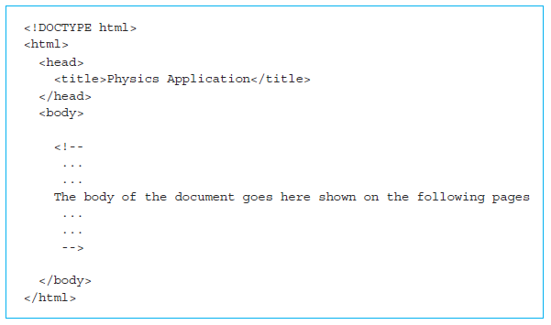
How to create a simple HTML5 web page
Tags: instructions to the web browser regarding the display and behavior of a web page.
An HTML5 tag is enclosed in two angled braces <...>.

Slide 5
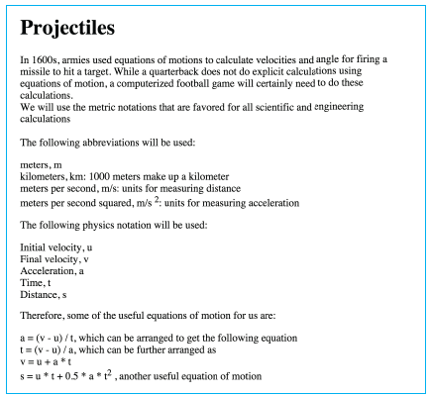
How to create a simple HTML5 web page (cont’d)
A screenshot of the complete page

Slide 6
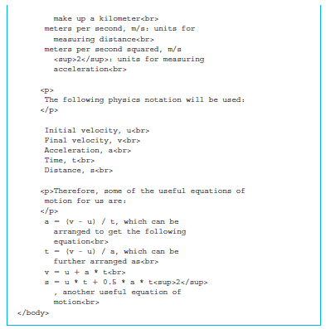
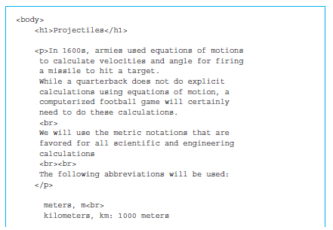
How to create a simple HTML5 web page (cont’d)
The rest of the HTML5 code that goes into the <body> section

Slide 7
How to create a simple HTML5 web page (cont’d)
The browsers uses physical line breaks based on the HTML5 tags.
Other line breaks: come from two tags, <p>...</p> and <br>.
One of the best resources which provides a comprehensive introduction to HTML5:
http://www.w3schools.com

Slide 8
How to put an HTML5 web page on the Internet
Directory called “web”.
Example: ch02/physicsProjectileApp0/version1
look for a file called physicsProjectileApp.html
Assume Windows as the default operating system for the rest of the discussion.
Putting the app code on the web is the easiest way to download and distribute it to multiple mobile devices through wireless communication.
Contact an Internet Service Provider (ISP)

Slide 9
How to put an HTML5 web page on the Internet (cont’d)
An account on a server with the domain name called cs.smu.ca.
The domain name is translated into an IP address.
An IP address is used to refer to any computer on the Internet.
Web server: typically an Internet-accessible computer that is specially configured to serve and receive documents at very high rates of transmission.
Apache
Microsoft Exchange Server

Slide 10
Example
Put our first HTML5 web page on the web for accessing it from any web-enabled device.
Linux server
Put our web pages in a folder called public_html. They will be accessible to the rest of the Internet using the URL: http://cs.smu.ca/~mobilebook.
Transfer files from personal computer to the web server cs.smu.ca.
WinSCP

Slide 11
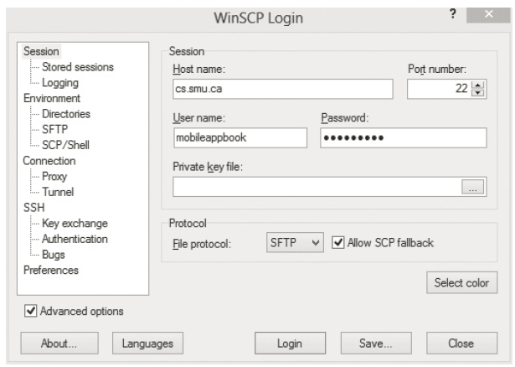
Screenshot of the login screen for WinSCP to upload the web pages

Slide 12
Example (cont’d)
Permissions in the UNIX environment
Linux and Mac OS X
Users: “owner”, “group”, “world”
The web server program: considered to be a user on the computer system and usually a part of the set of users called world or others.
Three types of permissions: read (R), write (W), and execute/run (X).
Reading, writing, and executing

Slide 13
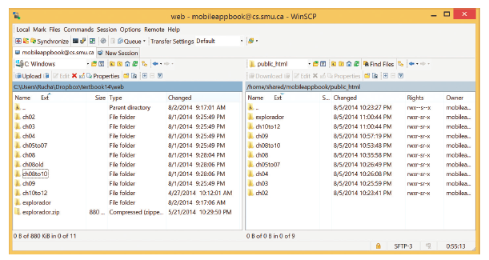
Screenshot of the WinSCP after logging in

Slide 14
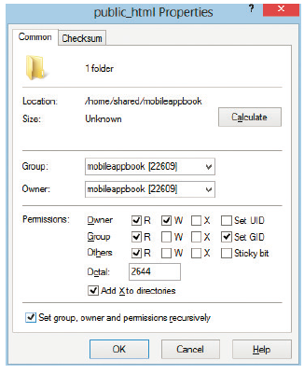
Example (cont’d)
Permission settings
All the files under the folder public_html and recursively all its subfolders need to be readable by everyone.

Slide 15
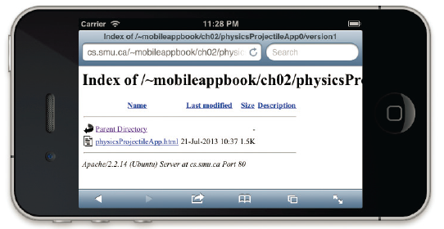
Example (cont’d)
Type in our URL, http://cs.smu.ca/~mobileappbook, in the browser’s address window.
HTML5 web page: physicsProjectileApp.html

Slide 16
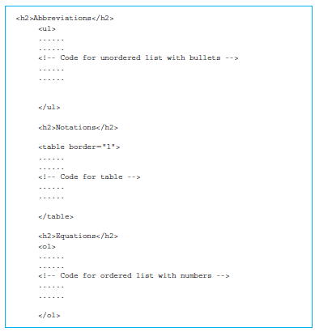
More HTML5 formatting
High-level view of the newly formatted part of the web page.
Tags <h2>...</h2>

Slide 17
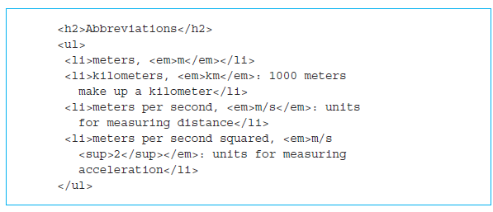
Unordered and ordered lists
An unordered list: a list that does not specify an order with numbers or alphabets.
The complete list is enclosed in a pair of tags <ul>...</ul>.
Added four items to the list using the pair of tags called
<li>...</li>.
An ordered list uses numbers or alphabets for listing items.

Slide 18
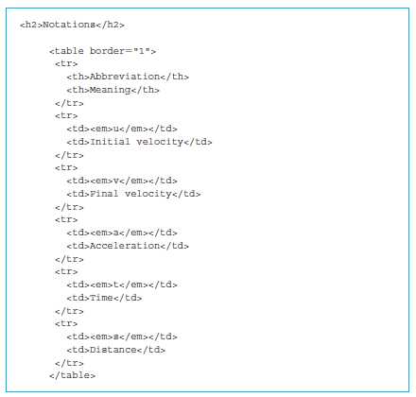
HTML5 tables
Look at http://www.w3schools.com
A table consists of rows enclosed in <tr>...</tr> tags and columns enclosed in either <th>...</th> or <td>...</td>.

Slide 19
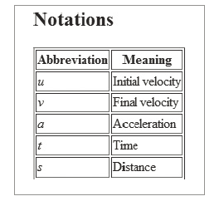
Screenshot of a table

Slide 20
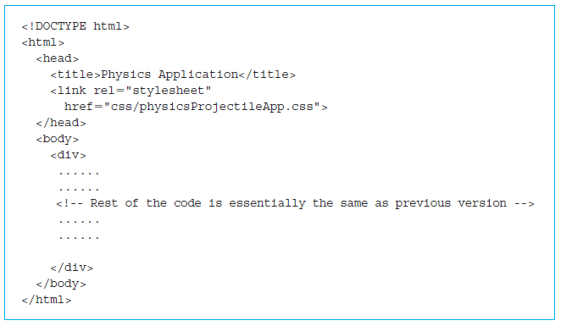
Cascading Style Sheets (CSS)
Adding fonts and color information to every single page
Long and expensive process.
Cascading style sheets (CSS) to mitigate this problem.
From HTML 4.0, all formatting can be stored in a separate CSS file.

Slide 21
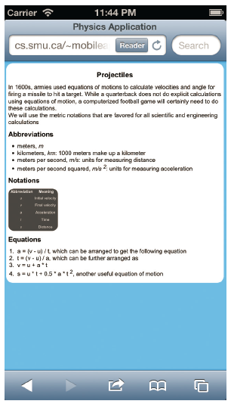
Screenshot of a web page that uses a cascading style sheet

Slide 22
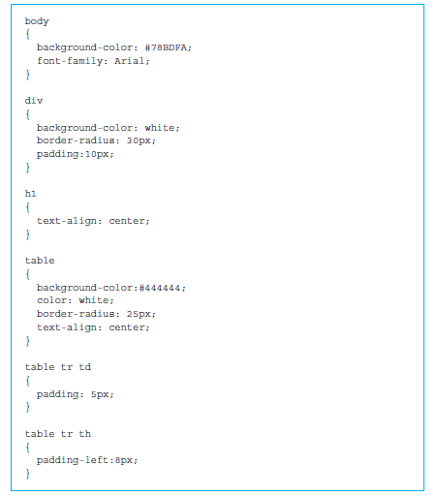
A cascading style sheet (CSS)
The <link> tag
Creating a “css” directory under the directory where our web page is located: ch02/physicsProjectileApp0/version3/css.

Slide 23
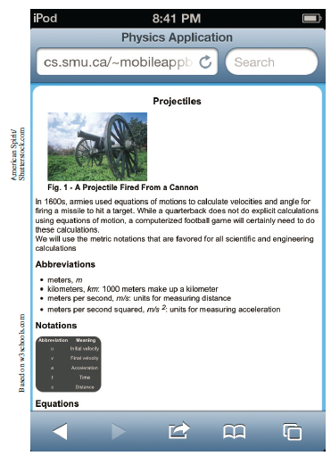
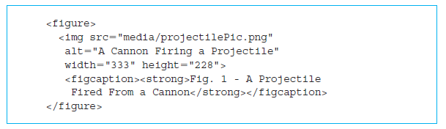
Adding some multimedia
HTML5 called <figure>...</figure> allows us to format a figure in our web page.
Often used in conjunction with a nested pair of tags <figcaption>...</figcaption>.
<figcaption> allows us to provide a caption underneath the figure.

Slide 24
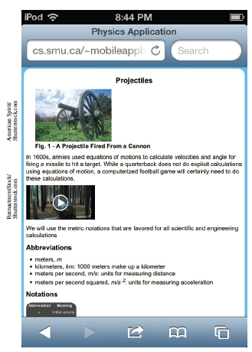
Augmented the page with a video
The <video> tag must have a nested tag called <source>.

Slide 25
Quick facts/buzzwords
<body> </body>: A pair of HTML5 tags that enclose the body section of an HTML document.
<p> </p>: A pair of HTML5 tags that enclose a paragraph in an HTML document.
<br>: An HTML5 tag used to add a line break in an HTML document.
<sup> </sup>: A pair of HTML5 tags that are used to display a superscript in an HTML document.
http: HyperText Transfer Protocol for transmitting web pages on the Internet.
ftp: File Transfer Protocol for transmitting files on the Internet.
scp: Secure Copy Protocol, a secure alternative to ftp.
secure ftp: A secure alternative to ftp.

